Slide 1
Ol’Chat
Final prototype

Slide 2
What we knew…
Not familiar with new technologies
Very few own a smartphone
Hearing/viewing issues
Notes:
We knew that old people are not very familiar with technologies and new concepts.
We knew that very few of them own a smartphone.
We knew that elderly might have hearing and viewing issues.

Slide 3
…What we didn’t
What kind of app’ ?
What are they missing ?
Notes:
We didn’t know what kind of application someone over the age of 70 would like to use.
We didn’t know if there was something they would miss from their time we could use in our application.

Slide 4
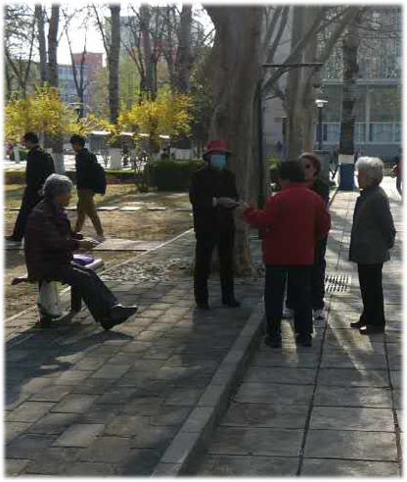
The interview
Almost no smartphones
A lack of enthusiasm
Notes:
Most of the interviewed didn’t have a cell-phone.
Not a lot of interest in the subject.

Slide 5
Gems
Keep it simple
Large buttons/UI
Not a lot of smartphones
Notes:
After a brainstorming session we found 3 important notions that we would like to integrate into our project, 3 gems :
_ Keep it simple
_ The majority of elderly people don’t own a smartphone
_ Use large buttons

Slide 6
Our idea
Easy to use UI
Large buttons
Essential informations
Notes:
Our idea was to build a UI that would be as easy as possible to understand and to use. That’s why we decided to create a very simple user interface with large buttons and just the very essential informations needed by a person who is not used to deal with apps in general.

Slide 7
Demo
First prototype

Slide 8
Tests and feedbacks
Missing search bar
Favorites as entry page
Keyboard with larger buttons
Audio/video calling
Notes:
The application is quite simple but misses the possibility to search for contacts and maybe we shouldn’t display the favorites contact as the entry page of the application. It was also mentioned that we should add the opportunity of having a keyboard with larger buttons to allow people with sight issues to type easily. It was also asked if we could add a calling option into the app.

Slide 9
How did we apply the feedbacks ?
New entry page
New audio/video call option
Use a different keyboard (larger buttons)
Notes:
We modified the entry page and made so that the user would access a list of all his contacts in the form of a succession of large buttons that you can scroll into. We also added a call option to allow the user to connect with another user via audio or video chat. It is now possible to use a different type of keyboard with larger buttons.

Slide 10
Demo
Final prototype

Slide 11
Thanks !

